Slide 1

Introduction to Fair Trade

Slide 2

Philosophy
‘God loves those who are fair and just.’
Quran (49:9)
It is not just that some should have less in order that others may prosper.
A Theory of Justice (Chapter I, Section 3)
A false balance is an abomination to the Lord, but a just weight is His delight.
Proverbs (11.1)
Maat, Isis, Dike, Justitia, Lady Justice

Slide 3
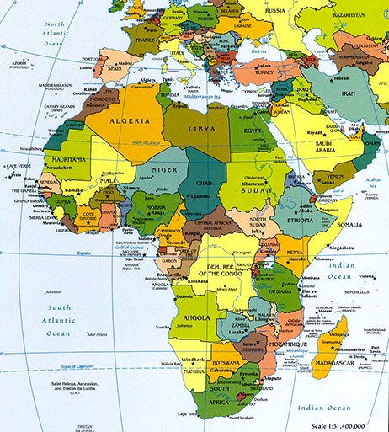

Trade and colonialism

Slide 4


Global trade rules...
Separate rules for agriculture and textiles
Reducing subsidies
Wrapped up in aid and debt
Primary products
...increase inequality

Slide 5





The Movement
Fair Trade crafts begin to be sold in the US and Europe
Max Havelaar label is set up
South Africa
Anti-apartheid trading
Fair Trade Town
Student
movement starts campaigning against trade
deals
Fairtrade Foundation label chocolate
Solidarity
trade with South America
Fair Trade Nation

Slide 6
How do we do it?

Slide 7




What is Fair trade? FINE
"Fair trade is a trading partnership, based on dialogue, transparency and respect, that seeks greater equity in international trade. It contributes to sustainable development by offering better trading conditions to, and securing the rights of, marginalized producers and workers – especially in the South. Fair trade organizations, backed by consumers, are engaged actively in supporting producers, awareness raising and in campaigning for changes in the rules and practice of conventional international trade".

Slide 8

Fairtrade International
Minimum price which is agreed with producers
Work in co-operation (set up a Co-operative of which women must have a representation)
Respect for the environment (incl no use of pesticide or GM)
Health & Safety and Human Rights regulations (incl no forced child labour)
An additional Fairtrade premium which can be invested in projects that enhance social, economic and environmental development

Slide 9

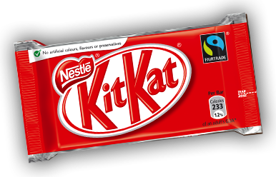
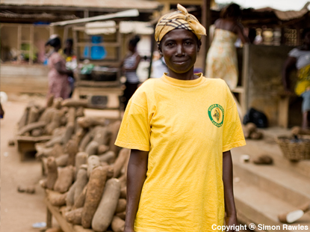
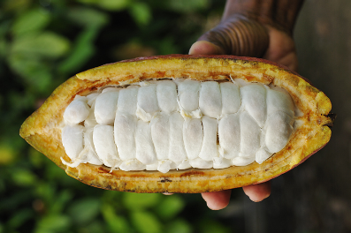

Kavokiva

Slide 10
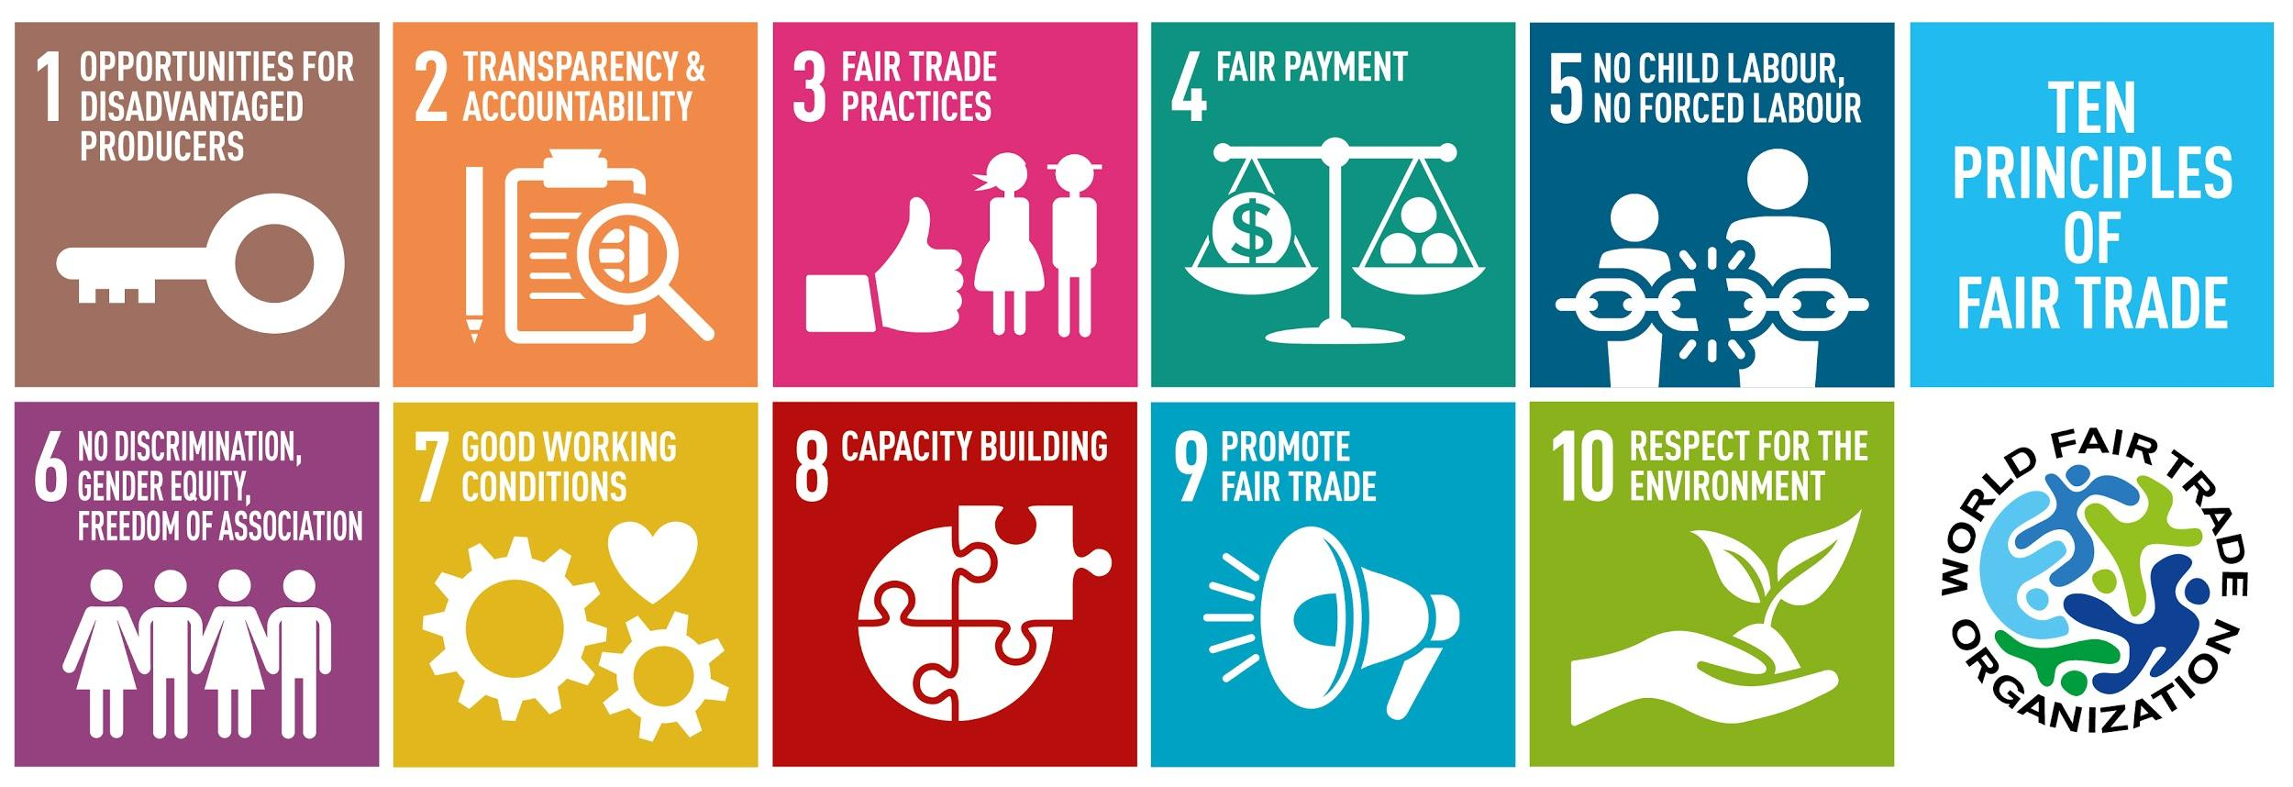
World Fair Trade Organization

Slide 11

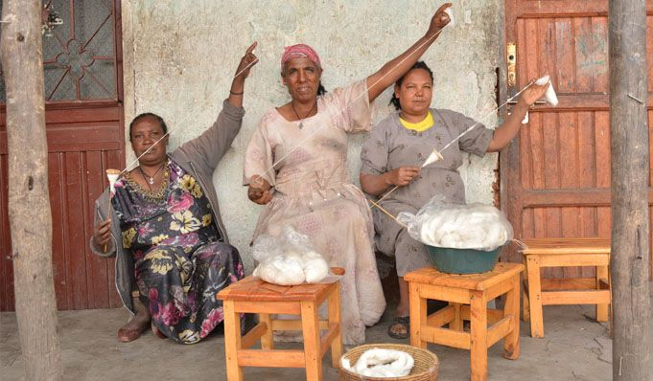
Sole rebels

Slide 12
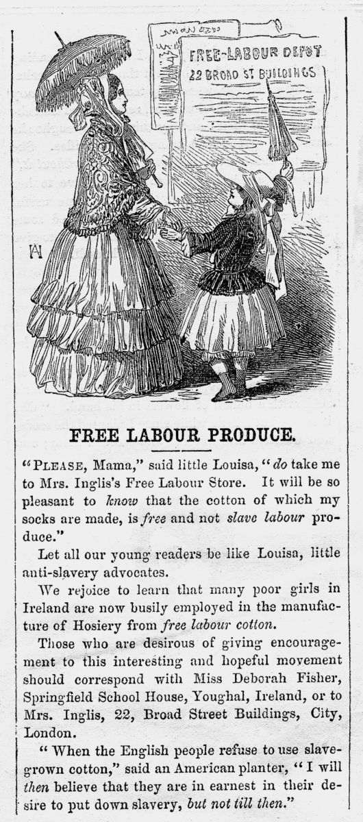

Find out more:
www.fairtradewales.com
www.fairtrade.org.uk
Email:
info@fairtradewales.com
Twitter: @fairtradewales
F’book: Fair Trade Wales

