Slide 1
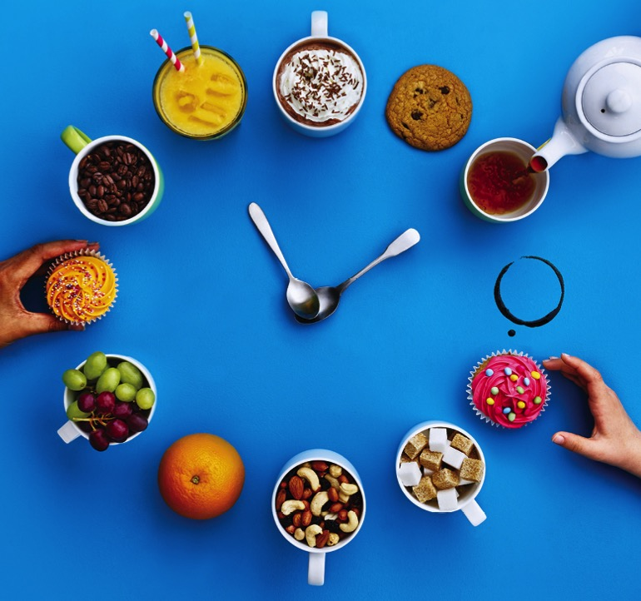
Yw hi’n bryd cynnwys Masnach Deg yn eich hegwyl?
Notes:
Time to put Fairtrade in our break?
Introduce the lesson with slide 1, reminding pupils that the school is taking part in Fairtrade Fortnight by holding a Fairtrade break, and this is a chance to understand a bit more about why the pupils and teachers have decided to do this.
For pupils who are new to Fairtrade and thinking about where their food comes from, it’s worth reminding them that Fairtrade is all about helping the farmers in other countries who grow our food to earn enough money, because many of them are so poor they can’t even feed their own families or buy medicines and send their children to school.
Start by asking the class what they like to do during break time, perhaps they could vote on whether they prefer playing sport in the playground or chatting with their friends. Then ask them if they think having a break is important, and why. What reasons can they think of?

Slide 2
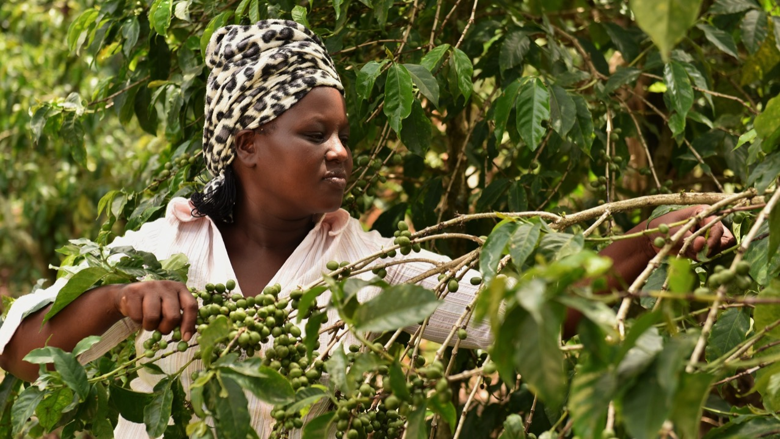
Pam mae cael egwyl yn bwysig?
Rhoi Ennyd i ni rhwng gwersi
Rhoi egni i ni ar gyfer Gwersi
GWneud ymarfer corff yn haws
Yn ein helpu i aros yn effro
GweLla’n hiechyd
Notes:
Why is break time important?
Pupils might mention:
The need to have a break from lessons
Using the break to have a snack that will give us the energy that is required for class
The need for exercise; we’re supposed to do at least 30 minutes a day at school
How having a break can leave us feeling more awake
All of the above allow us to be more healthy

Slide 3
Pam yda ni’n bwyta byrbryd ac yn yfed diod yn ystod yr egwyl?
egni
iach
penysgafn
dŵr
Cur pen
blinedig
canolbwyntio
Eisiau bwyd
Rhwng prydau
Notes:
Choosing the best snack!
Use slide 3 to ask pupils why they think we eat and drink during a break, using some of the vocabulary and ideas on the slide. They could ask a partner and give a reason each, thinking about
Our bodies need extra energy between meals
Our tummy can rumble in lessons when we’re hungry
Discuss loss of concentration in lessons if energy levels drop
When we get hungry we can get tired and sometimes dizzy

Slide 4
Pa fyrbrydau amser egwyl yw’r iachaf?
Pa rai sy’n iawn i’w bwyta weithiau?
Pa rai fuasech chi’n eu hosgoi?
Pa ddiod iach sydd ar goll?
Pa rai o’r rhain sy’n Fasnach Deg yn eich barn chi?
Notes:
Using slide 4, pupils could talk in small groups or write down answers to the questions about the foods, drinks and snacks in the picture. They could even use the clock to say “I would avoid the snack at 5 o’clock!”
Some learning points:
Encourage consumption of fruit and vegetables and at least five a day – some could be Fairtrade
Having one glass of fruit juice a day is healthy
Some foods like cakes and biscuits aren’t very healthy because they can be higher in sugar and fat
It’s Important to stay hydrated with water or milk, and avoiding drinks high in sugar such as fizzy or fruit-based drinks

Slide 5
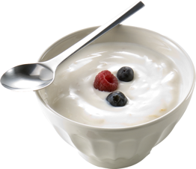
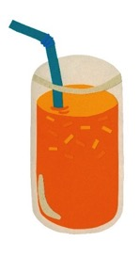
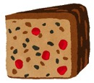
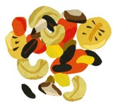
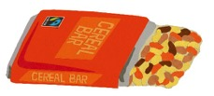
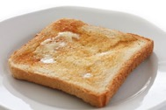
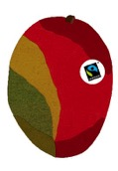
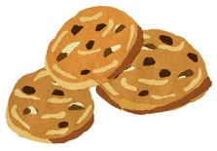
Byrbrydau iach a syniadau ar gyfer eich hegwyl!
Notes:
But why bother with a Fairtrade snack?
Show pupils slide 5 and ask them to point out any patterns, such as how many snacks are fresh fruit and vegetables, how many contain sugar, how many are Fairtrade or how many are drinks.

Slide 6
Mae'n byrbrydau’n dod o bedwar ban byd
Nid yw ffermwyr yn gwneud digon o arian i gynnal eu teuluoedd .
Notes:
But what difference does choosing a Fairtrade snack make, and should we bother? Show slide 6 to introduce the idea that our food comes from around the world

Slide 7
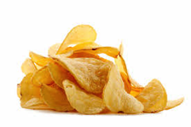
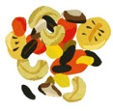
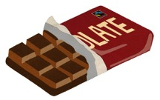
Iach, Masnach Deg neu’r ddau?
Notes:
Fairtrade break plenary
Using slides 7-8, get pupils to sort the snacks into a venn diagram – healthy, Fairtrade or both. Are there any that don’t fit?
Some learning and recap points:
Wholemeal bread provides a slow release of energy – keeping you fuller for longer
Fruit and Vegetables give us lots of vitamin and minerals
Cereal bars – some are healthier than others. Those with chocolate will be higher in sugar.
Smoothies are another option to encourage fruit and vegetable intake
If we choose Fairtrade snacks during our break, we can even help farmers get a break themselves by helping them provide for their families.

Slide 8
Iach, Masnach Deg neu’r ddau?
Notes:
Slide 8 is a completed venn.

Slide 9
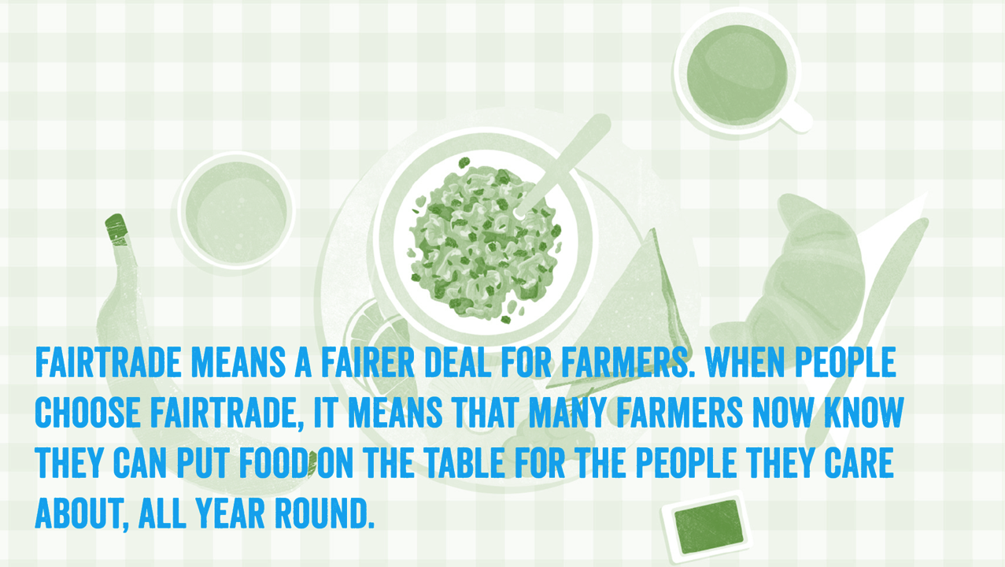
Mae Masnach Deg yn golygu bargen well i ffermwyr. Pan mae pobl yn dewis Masnach Deg, mae’n golygu y gall ffermwyr fwydo’u teuluoedd a’u cymunedau drwy gydol y flwyddyn
Notes:
If we choose Fairtrade snacks during our break, we can even help farmers get a break themselves by helping them provide for their families.

