Slide 1

What’s in store for Fairtrade?
Rachael Sweet
Communities Campaigns Officer

Slide 2
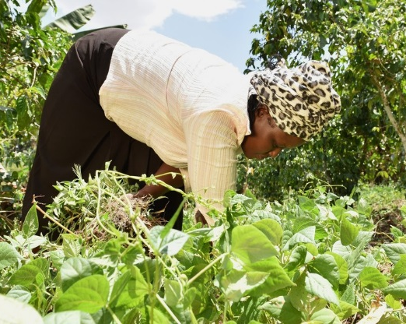
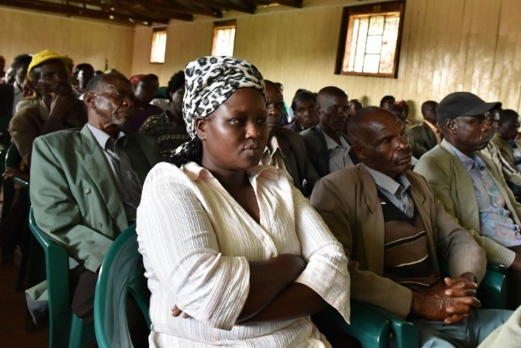
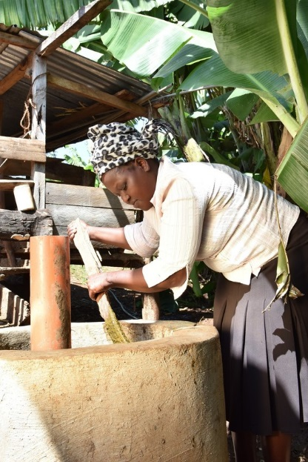
Meet Zeddy

Slide 3


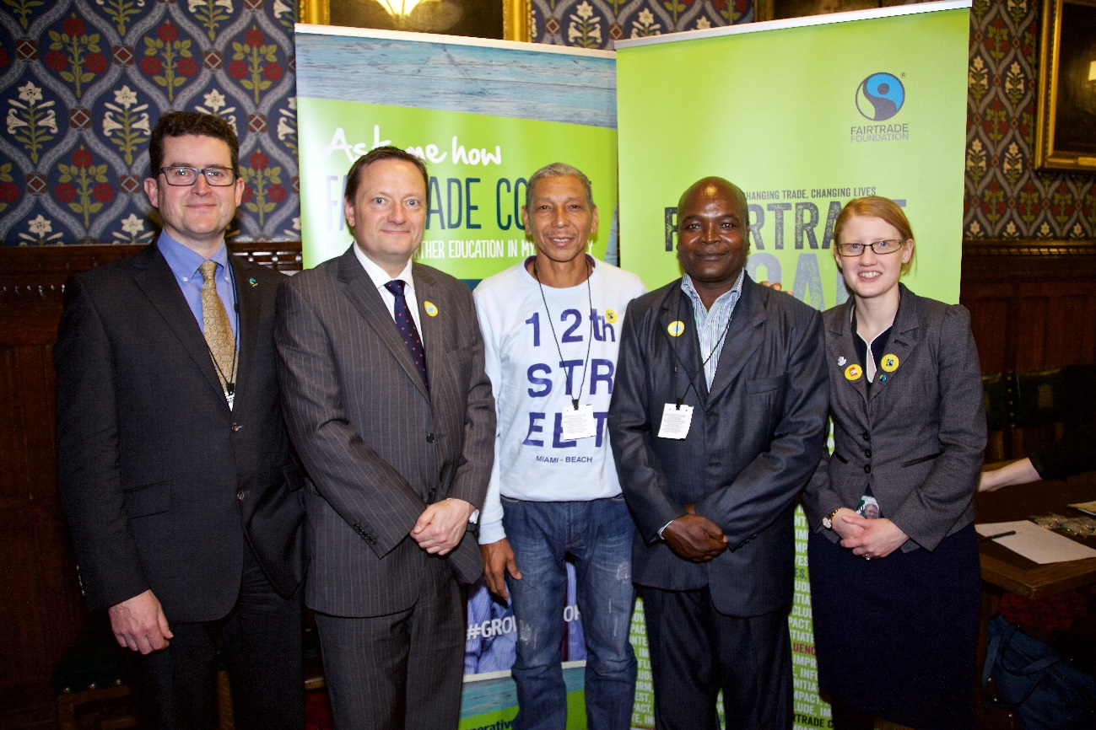
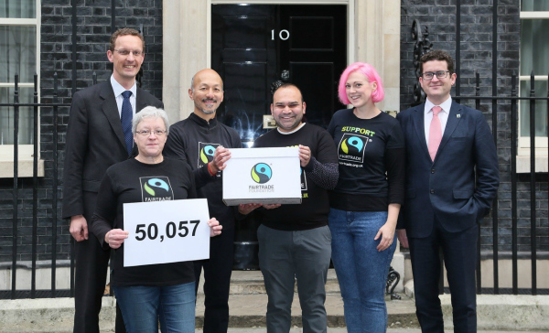
Influencing wider policy and practice change

Slide 4


Building public support

Slide 5


New challenges

Slide 6
New challenges

Slide 7






2016-2020 strategy: Fairtrade Can, I Can

Slide 8
The future: new creative platform

Slide 9

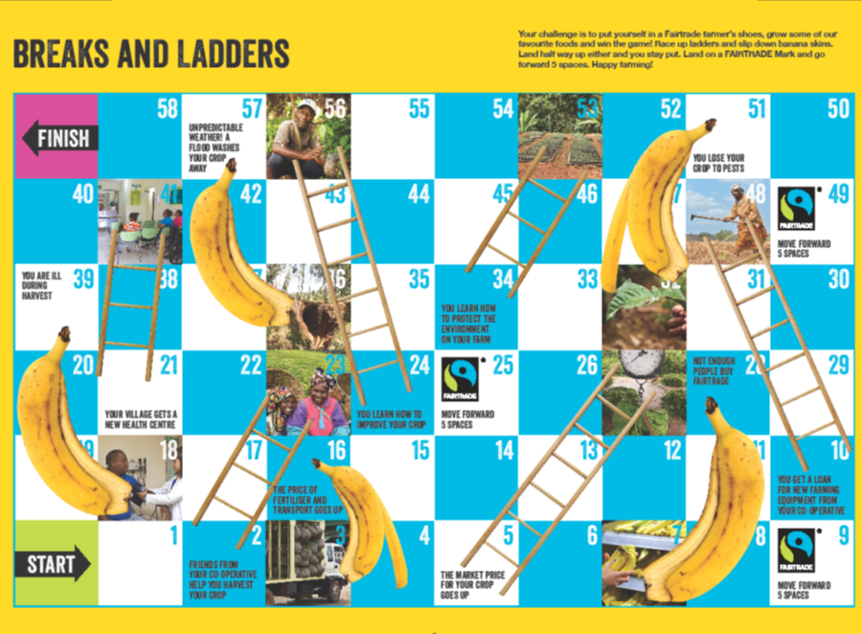


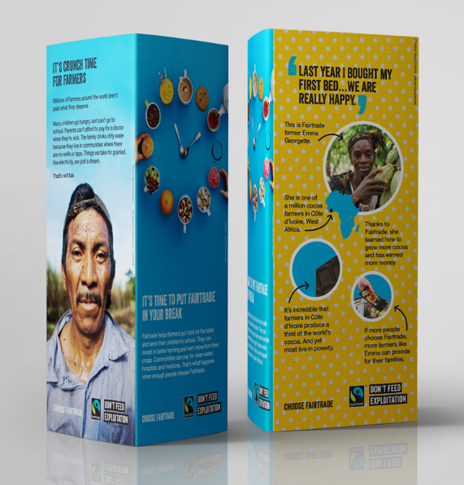
Fairtrade Fortnight 2017

Slide 10
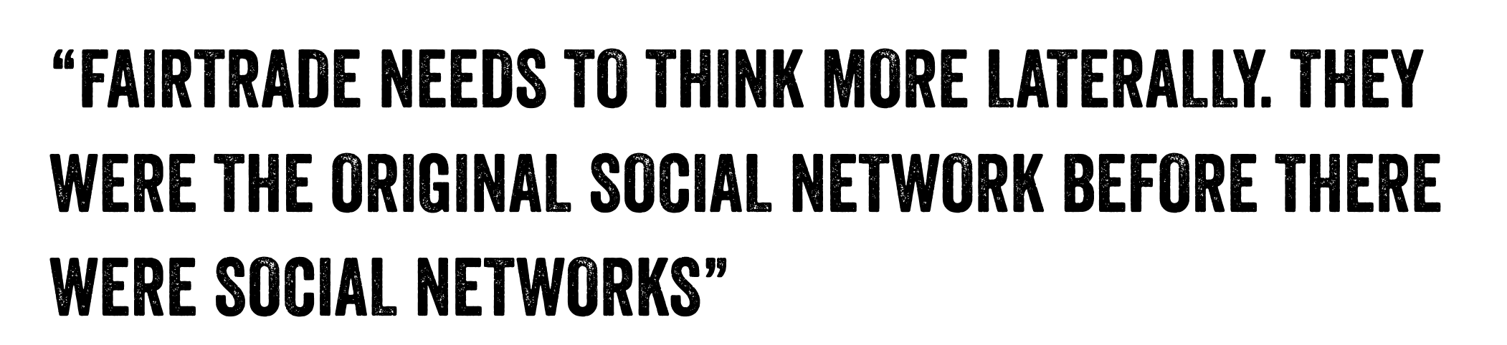


Slide 11



